Slide 1
Component Design

Slide 2
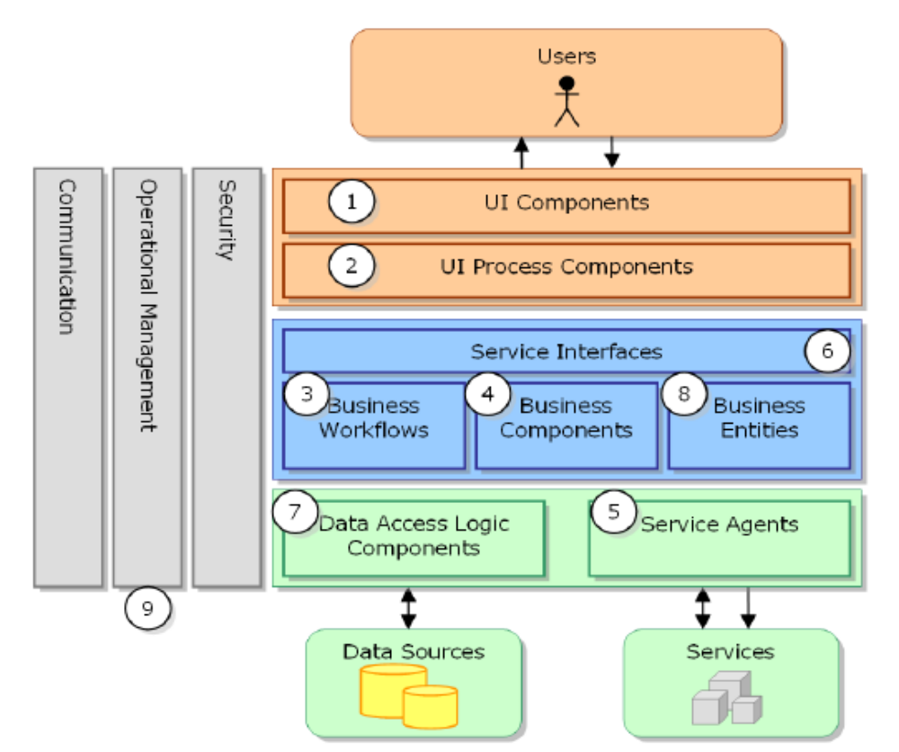
Most Commonly Used Components

Slide 3

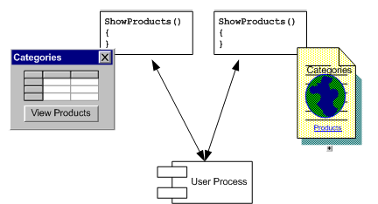
User Interface Component

Slide 4
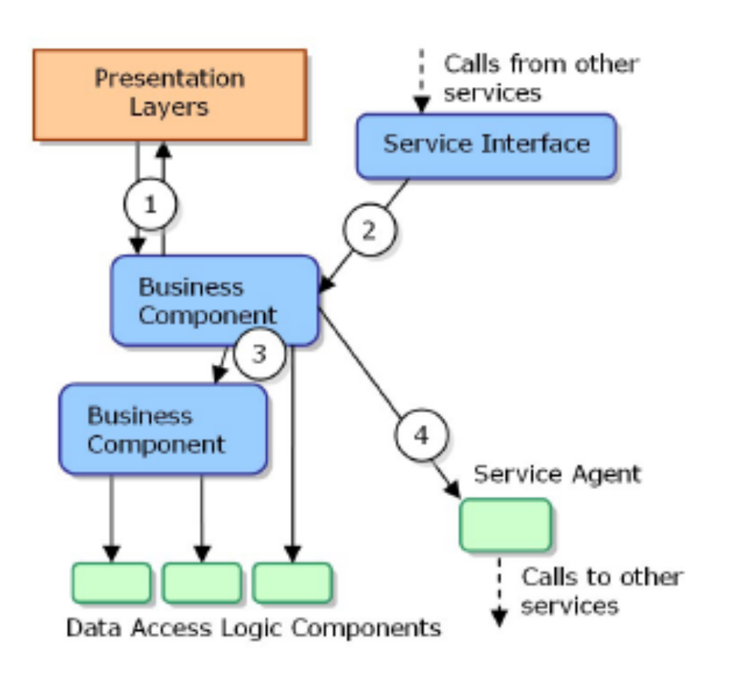
Business Components

Slide 5
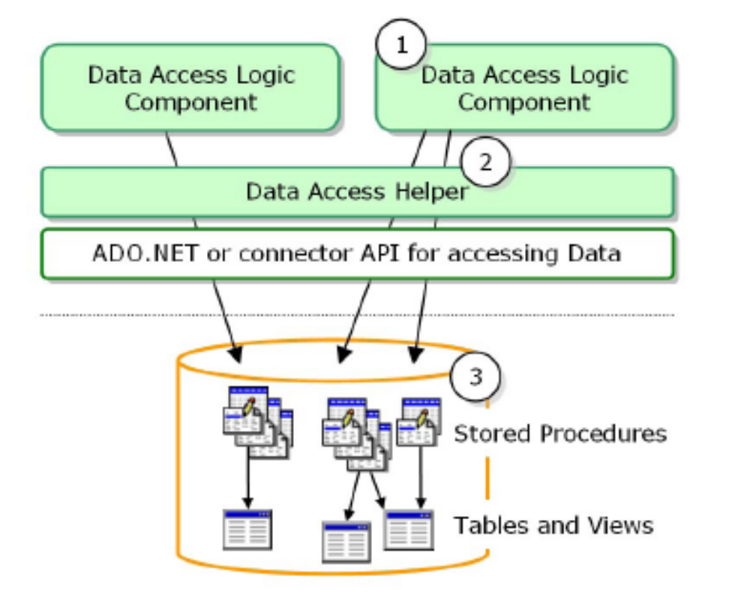
Data Access Logic Components

